Slide 1
Open Stack For
Open
Web Payments
Praveen Alavilli
Ray Tanaka

Slide 2
Agenda
Online Payments
State of the Online Payments
  Payment Networks
  Features and Functionality
A Case for Open Web Payments
Open Stack for Open Web Payments
Next steps / Call for Action

Slide 3
Payments – a look back !
EFT 1970s
PayPal 1998
Barter
100,000BC – 3,000BC
Commodity
3,000BC – 650BC
Cash
650BC - Now
Credit
1950 - Now
eCommerce
1981 (1984)
Payment Gateways
1995

Slide 4





















There are many players…
Notes:
A very important result of this is that a developer has to learn, code and deploy different integrations with each and everyone separately. It’s just painful.

Slide 5
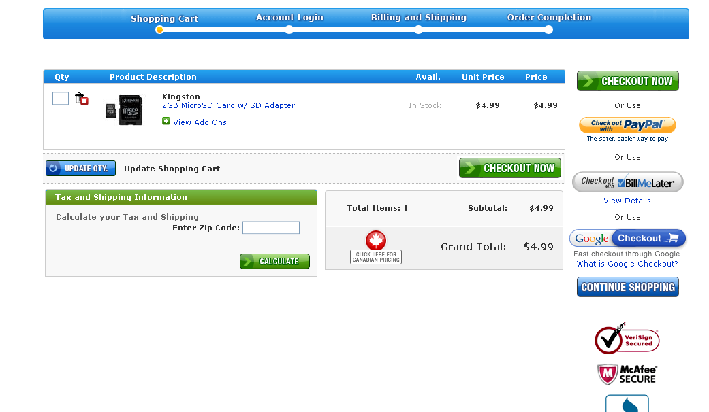

The Result: Fragmentation

Slide 6
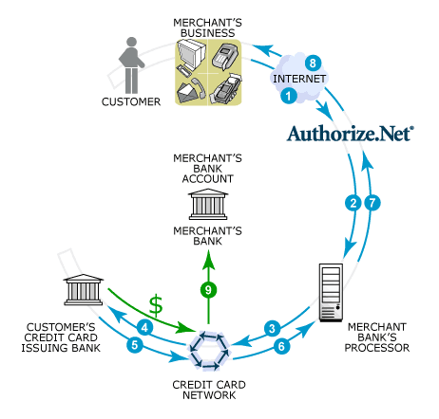
Payment Networks
Credit/Debit Card Networks
ACH
some gateway

Slide 7
Essential components of Online Payments
Authentication – Who are you?
Authorization – How much do you want to charge?
Payment Instrument – What are you using to pay?

Slide 8
Motivation
Reduce Friction
Interoperability across multiple payment platforms
PCI Compliance

Slide 9
Open Web Payments
Consistency APIs across platforms
Single model for authorization, payments and transactions
Support for real and virtual currencies
Single, extensible document model

Slide 10
What we’re not covering (for now)
Payment data portability (Merchant + Consumer)
Client, user and receiver account management
Direct integration with financial institutions

Slide 11
Transactions AS THE CORE

Slide 12
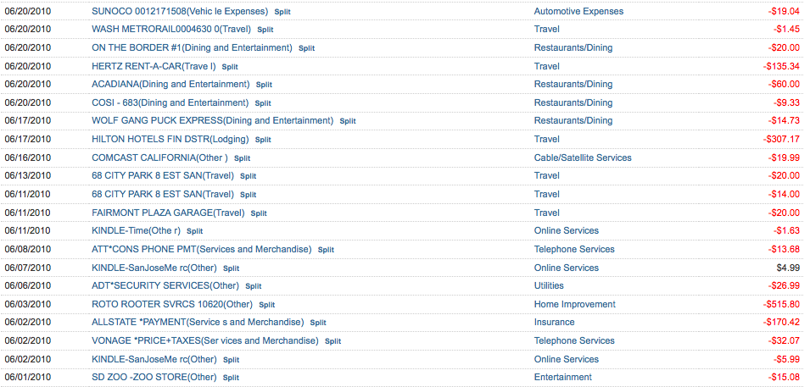

Slide 13
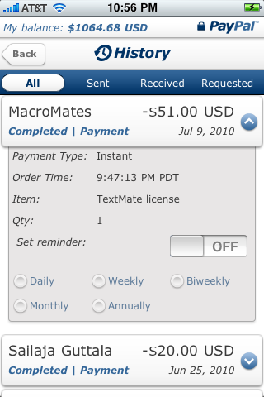
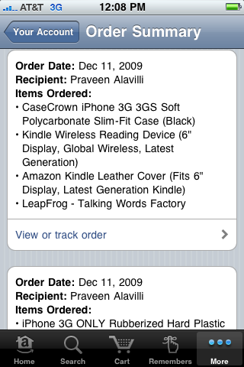


Slide 14

The closest sibling on the web !

Slide 15
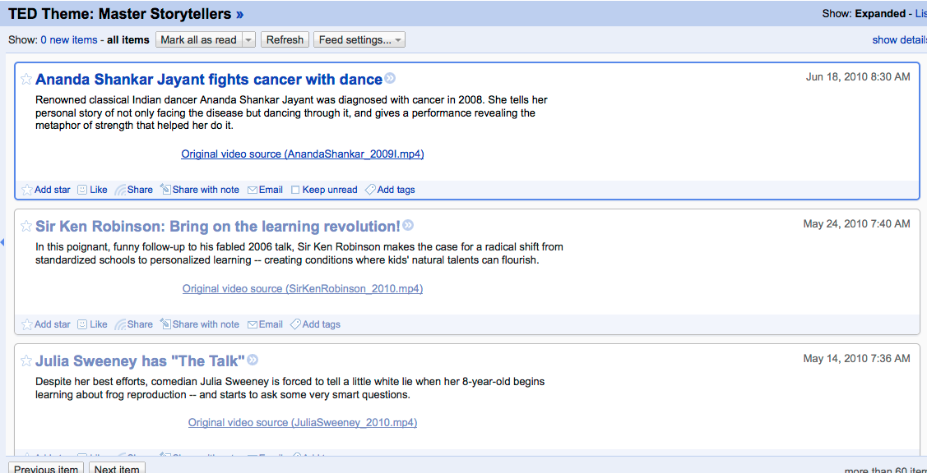
Feeds – web resources

Slide 16
Feeds – A closer Look
<entry>
<id>tag:blogger.com,1999:blog-754260340057137512.post-2123024611142172293</id>
<published>2010-03-11T13:46:00.001-05:00</published>
<updated>2010-03-11T13:46:50.788-05:00</updated>
<category scheme='http://www.blogger.com/atom/ns#' term='wallet'/>
<title type='text'>Fueling the Wallet.Next</title>
<content type='html'>……</content>
<link rel='alternate' type='text/html' href='http://whyidentity.blogspot.com/2010/03/fueling-walletnext.html' title='Fueling the Wallet.Next'/>
<link rel='replies' type='text/html' href='https://www.blogger.com/comment.g?blogID=754260340057137512&amp;postID=2123024611142172293' title='0 Comments'/>
<author>
<name>Praveen</name>
<uri>http://www.blogger.com/profile/10778095038892167017</uri>
<email>noreply@blogger.com</email>
</author>
</entry>

Slide 17
Transactions – A closer look
Date
Sender – Payer, Buyer, Customer
Receiver - Friend, Merchant, Seller, Some Service Provider)
Type of Payment – instant, subscription, pre-pay, post-pay, refund, agreement to pay in future
Reason for payment – purchase, personal, gift, etc.
Category – Restaurant, Merchandise, Travel, etc.
Unique identifier
Amount and Currency
Status
Application/Client– Web Site, Mobile Application, etc.

Slide 18
Mapping Transaction → ATOM Entry
Transaction | Atom Entry
Date | published
Reference Id | id
Reason for Payment | title/summary
Application/Client | author
Category | link
Item List | link
Summary/memo | content

Slide 19
Open Web Payments Extensions
Filling in the missing pieces in the puzzle

Slide 20
ATOM
An XML-based Web Content and metadata syndication format

Slide 21
POCO
Simple, Portable and Standard Contact schema
Shipping & Billing Address -- poco:address

Slide 22
OAUth 2.0
Request (Client) Authentication
End User Authorization (Transaction Approval)
Little sketchy !

Slide 23
ATOMPub
Application level protocol for publishing and editing web resources

Slide 24
So what’s our open stack ?
Consumer
Application
Transaction
History
Application
Merchant
Application
OpenSearch
Open Web Payment
PoCo
Atom
Open
Web
Payments
Stack
AtomPub
OAuth
host-meta/WebFinger
Payments Provider

Slide 25
How does this work ?

Slide 26
Transactions represented by an Entry
<entry>
<id> -unique-transaction-id- </id>
<title type=“text”> -short desc of transaction- </title>
<published> -transaction creation date- </published>
<author>
<name>-name of the app-</name>
<uri>-app url-</uri>
<id>-unique-app-identifier-</id>
<OWP:consumer_id>-id-</OWP:consumer_id>
<OWP:consumer_transaction_id>-txn-id-</OWP:consumer_transaction_id>
</author>
<category scheme=“-iri-” term=“-category-” label=“-label-”/>
<link rel=“alternate” type=“text/html” href=“-url-to-receipt-”>
<content type=“xhtml”>-detailed-desc-</content>
<OWP:transaction>…</OWP:transaction>
</entry>

Slide 27
OWP:transaction
<OWP:action></OWP:action>
<OWP:status-type></OWP:status-type>
<OWP:start-date/>
<OWP:end-date/>
<OWP:entity>
<name/><uri/><email/><id/>
<OWP:entity-type></OWP:entity-type>
<OWP:amount currency=“”></OWP:amount>
<OWP:fundingType></OWP:fundingType>
<OWP:securePin></OWP:securePin>
<OWP:refTransactionId></OWP:refTransactionId>
<OWP:payment-type></OWP:payment-type>
<OWP:status-type></OWP:status-type>
<poco:address/>
</OWP:entity>

Slide 28
OWP:transaction
OWP:action:
  http:/owp-api.net/schema/1.0/verbs/Pay
  http://owp-api.net/schema/1.0/verbs/PrePay
  http://owp-api.net/schema/1.0/verbs/PostPay
  http://owp-api.net/schema/1.0/verbs/PrePayAgreement
  http://owp-api.net/schema/1.0/verbs/PostPayAgreement
  http://owp-api.net/schema/1.0/verbs/DelegatedPaymentAgreement
  http://owp-api.net/schema/1.0/verbs/HoldFunds
OWP:entity-type:
  http://owp-api.net/schema/1.0/entity-types/Sender
  http://owp-api.net/schema/1.0/entity-types/Receiver
  http://owp-api.net/schema/1.0/entity-types/PrimaryReceiver
  http://owp-api.net/schema/1.0/entity-types/SecondaryReceiver
OWP:payment-type: http://owp-api.net/schema/1.0/payment-types/Personal
http://owp-api.net/schema/1.0/payment-types/Goods
  http://owp-api.net/schema/1.0/payment-types/Services
  http://owp-api.net/schema/1.0/payment-types/Donations
OWP:funding-type:
  http://owp-api.net/schema/1.0/funding-types/Bank
  http://owp-api.net/schema/1.0/funding-types/Card
  http://owp-api.net/schema/1.0/funding-types/Gold
OWP:status-type: http://owp-api.net/schema/1.0/status-types/Created
  http://owp-api.net/schema/1.0/status-types/Pending
  http://owp-api.net/schema/1.0/status-types/Complete
  http://owp-api.net/schema/1.0/status-types/Canceled

Slide 29
  http://owp-api.net/schema/1.0/actions/PrePayAgreement http://owp-api.net/schema/1.0/actions/PostPayAgreement
Prior agreement between Sender and Receiver
PrePay Agreement results in money movement
PostPay Agreement results in no money movement
Requires end user authorization

Slide 30
  http://owp-api.net/schema/1.0/actions/PrePay http://owp-api.net/schema/1.0/actions/PostPay
PrePay is for transaction recording purposes – no money movement
PostPay is for merchant credit functionality – no money movement

Slide 31
  http://owp-api.net/schema/1.0/actions/DelegatedPaymentAgreement
Delegate access to the application to make Payments on behalf of the user
Requires end user authorization.
Allows to set max amount allowed, max number of payments, frequency, start/end dates, and receivers.

Slide 32
  http://owp-api.net/schema/1.0/actions/HoldFunds
No money movement but funds are held in for a specific receiver
Requires end user authorization
Allows to set amount, and expiry.

Slide 33
  http://owp-api.net/schema/1.0/actions/Pay
For money movement from sender to receiver.
In most cases requires end user authorization.
No explicit user authorization required when used with a TransactionId for previously held funds or Delegated Payment access or when sender is same as Client

Slide 34
Authentication and Authorization
OAuth 2.0 ?
2-legged or 3-legged
Need Access Token ?
How to do dynamic user approvals ?
Implicit and User Federations

Slide 35
Discovery
https://service.provider.com/.well-known/host-meta
<?xml version='1.0' encoding='UTF-8'?>
<XRD xmlns='http://docs.oasis-open.org/ns/xri/xrd-1.0'
xmlns:hm='http://host-meta.net/ns/1.0'>
<hm:Host>service.provider.com</hm:Host>
<Link rel='http://owp-api.net/1.0/provider'
href='http://service.provider/openpayments'>
</XRD>

Slide 36
API
Action | HTTP Method | Content Type | Return Values
Create Transaction | POST | AtomEntry | AtomEntry or Entry URI
Update Transaction | GET, PUT | AtomEntry | HTTP Status Code
Refund Transaction | GET, PUT | AtomEntry | HTTP Status Code
Transaction Details | GET | AtomEntry | AtomEntry
Transaction Search | GET | AtomFeed | AtomFeed
Notifications (IPNs) | POST | AtomEntry

Slide 37
Putting this all together – a grocery app
<entry>
<id>https://paymentsservice.com/owp/transaction/id/12345678</id>
<published>2010-07-15T01:46:00.001-05:00</published> <updated>2010-07-14T08:00:50.788-05:00</updated>
<category scheme='http://openpayment.org/atom/ns#' term='groceries' label="Groceries"/>
<category scheme='http://www.blogger.com/atom/ns#' term='store' lavel="Safeway"/>
<title type='text'>Groceries from Safeway</title>
<content type='html'>
<ul><li>2% Milk</li><li>2 Gallons Water</li><li>2lb Tomatos</li></ul>
</content>
<link rel='alternate' type='text/html' href='http://www.safeway.com/order-status' title='Safeway online Store'/>
<author>
<name>Your Grocery App</name>
<uri>http://your-grocery-app.com</uri>
<email>support@yourgroceryapp.com</email>
<OWP:consumer_id>api-caller:1234</OWP:consumer_id>
</author>

Slide 38
Putting this all together – a grocery app
<OWP:transaction>
  <OWP:action>http://owp-api.net/schema/1.0/object-types/Pay</OWP:action>
  <OWP:entity>
  <OWP:entity-type>http://owp-api.net/schema/1.0/entity-types/Sender</OWP:entity-type>
  <name>Praveen Alavilli</name><uri>https://me.paypal.com/id/1234567</uri><email>praveen@x.com</email>
  <OWP:funding-type>http://owp-api.net/schema/1.0/funding-types/Bank</OWP:funding-type>
  <OWP:funding-type>http://owp-api.net/schema/1.0/funding-types/CreditCard</OWP:funding-type>
  <OWP:funding-type>http://owp-api.net/schema/1.0/funding-types/DebitCard</OWP:funding-type>
  </OWP:entity>
  <OWP:entity>
  <OWP:entity-type>http://owp-api.net/schema/1.0/entity-types/Receiver</OWP:entity-type>
  <name>Safeway Store</name><uri>https://biz.paypal.com/id/7654321</uri><email>support@safeway.com</email>
  <OWP:amount currency="USD">25.50</OWP:amount>
  <OWP:payment-type>http://owp-api.net/schema/1.0/payment-types/Goods</OWP:payment-type>
  </OWP:entity>
  <OWP:entity>
  <OWP:entity-type>http://owp-api.net/schema/1.0/entity-types/Receiver</OWP:entity-type>
  <name>Your Grocery App</name><uri>https://biz.paypal.com/id/432156</uri><email>support@yourgroceryapp.com</email>
  <OWP:amount currency="USD">2.00</OWP:amount>
  <OWP:payment-type>http://owp-api.net/schema/1.0/payment-types/Services</OWP:payment-type>
  </OWP:entity>
</OWP:transaction>
</entry>

Slide 39
Digital Goods app – using Pre-Pay
<entry>
<id>https://paymentsservice.com/owp/tranaction/id/2123024611142172293</id>
<published>2010-07-15T01:46:00.001-05:00</published> <updated>2010-07-14T08:00:50.788-05:00</updated>
<category scheme='http://owp-api.net/atom/ns#' term=’coins' label=”Coinsville Coins"/>
<title type='text'>Buying coins on Coinsville</title>
<content type='html’>PrePay for Coinsville</content>
<link rel='alternate' type='text/html' href='http://coinsville.com/account' title=’Coinsville Account Page'/>
<author>
<name>Digital Goods App</name><uri>http://digitalgoodsapp.com</uri>
<email>support@digitalgoodsapp.com</email>
<OWP:consumer_id>api-caller:654321</OWP:consumer_id>
</author>
<OWP:transaction>
  <OWP:action>http://owp-api.net/schema/1.0/object-types/PrePayAgreement</OWP:action>
  <OWP:entity>
  <OWP:entity-type>http://owp-api.net/schema/1.0/entity-types/Sender</OWP:entity-type>
  <name>Praveen Alavilli</name><uri>https://me.paypal.com/id/1234567</uri><email>praveen@x.com</email>
  <OWP:funding-type>http://owp-api.net/schema/1.0/funding-types/Gold</OWP:funding-type>
  <OWP:amount currency=”bar">2</OWP:amount>
  </OWP:entity>
  </OWP:transaction>
</entry>

Slide 40
Digital Goods app – recording payment
<entry>
<id>https://paymentsservice.com/owp/tranaction/id/45402461154323434234</id>
<published>2010-07-15T01:46:00.001-05:00</published> <updated>2010-07-14T08:00:50.788-05:00</updated>
<category scheme='http://owp-api.net/atom/ns#' term=’coins' label=”Coinsville Coins"/>
<title type='text'>Purchase digital sword</title>
<content type='html’>Blazing sword</content>
<link rel='alternate' type='text/html' href='http://coinsville.com/order' title=’Coinsville Order Portal'/>
<author>
<name>Digital Goods App</name><uri>http://digitalgoodsapp.com</uri>
<email>support@digitalgoodsapp.com</email>
<OWP:consumer_id>api-caller:654321</OWP:consumer_id>
</author>
<OWP:transaction>
  <OWP:action>http://owp-api.net/schema/1.0/object-types/Pay</OWP:action>
  <OWP:entity>
  <OWP:entity-type>http://owp-api.net/schema/1.0/entity-types/Sender</OWP:entity-type>
  <name>Praveen Alavilli</name><uri>https://me.paypal.com/id/1234567</uri><email>praveen@x.com</email>
  <OWP:refTransactionId>https://paymentsservice.com/owp/tranaction/id/2123024611142172293</OWP:refTransactionId>
  </OWP:entity>
  <OWP:entity>
  <OWP:entity-type>http://owp-api.net/schema/1.0/entity-types/Receiver</OWP:entity-type>
  <name>Digital Sword Seller</name><uri>https://biz.paymentprovider.com/id/9832434</uri><email>support@sword.com</email>
  <OWP:amount currency=”bars”>0.25</OWP:amount>
  <OWP:payment-type>http://owp-api.net/schema/1.0/payment-types/Services</OWP:payment-type>
  </OWP:entity>
</OWP:transaction>
</entry>

Slide 41
Next Steps
Join the community and help in driving the spec
  OWP-API@googlegroups.com
  http://groups.google.com/group/owp-api
Validate the document model
Explore more use cases
Sample implementations
  Virtual Currency Provider
Payment Portability

Slide 42
Q & A ?
Contact us: @ppalavilli & @rtanaka
http://groups.google.com/group/owp-api

